Slide 1

DEPARTMENT OF ELECTRONICS AND COMMUNICATION ENGINEERING
“LOGISTIC REGRESSION ANALYSIS USING DISCRETE DATA FOR MACHINE LEARNING”

Slide 2
Contents
Details of Software knowledge acquired
Introduction of the project
Aim of project
Design and Implementation details
Results
Conclusion
References

Slide 3
MACHINE LEARNING
Machine learning is a branch of artificial intelligence and computer science which focuses on the use of data.
It describes how computer performs tasks on their own by previous experience.
Machine learning is a subset of artificial intelligence that allows machine to learn from data without being programmed.

Slide 4
SOFTWARE KNOWLEDGE ACQUIRED
Python
Anaconda(Jupyter)
NumPy
Pandas
Pylab
Statsmodels.api

Slide 5
INTRODUCTION OF PROJECT
Logistic regression is an example of supervised learning. It is used to calculate or predict the probability of a binary (yes/no) event occurringThe primary purpose is to discuss the prediction of student admission to university based on various factors and using logistic regression.
The admission decision depends on the criteria within the particular college.
The analysis is straight forward and consider the scores like GRE, university scores, GPA and so on.

Slide 6
AIM OF THE PROJECT
The aim of logistic regression is to provide accurate and reliable predictions.
To identify the various factors that may influence admission into graduate school.

Slide 7
DESIGN AND IMPLEMENTAION
Pandas: It used for data analysis tasks in python.it provides high performance data manipulation.
NumPy: It is a python library used for working with a array and it is module of python.
Statsmodels: It creates a pandas data frame that contains variables.

Slide 8


Slide 9
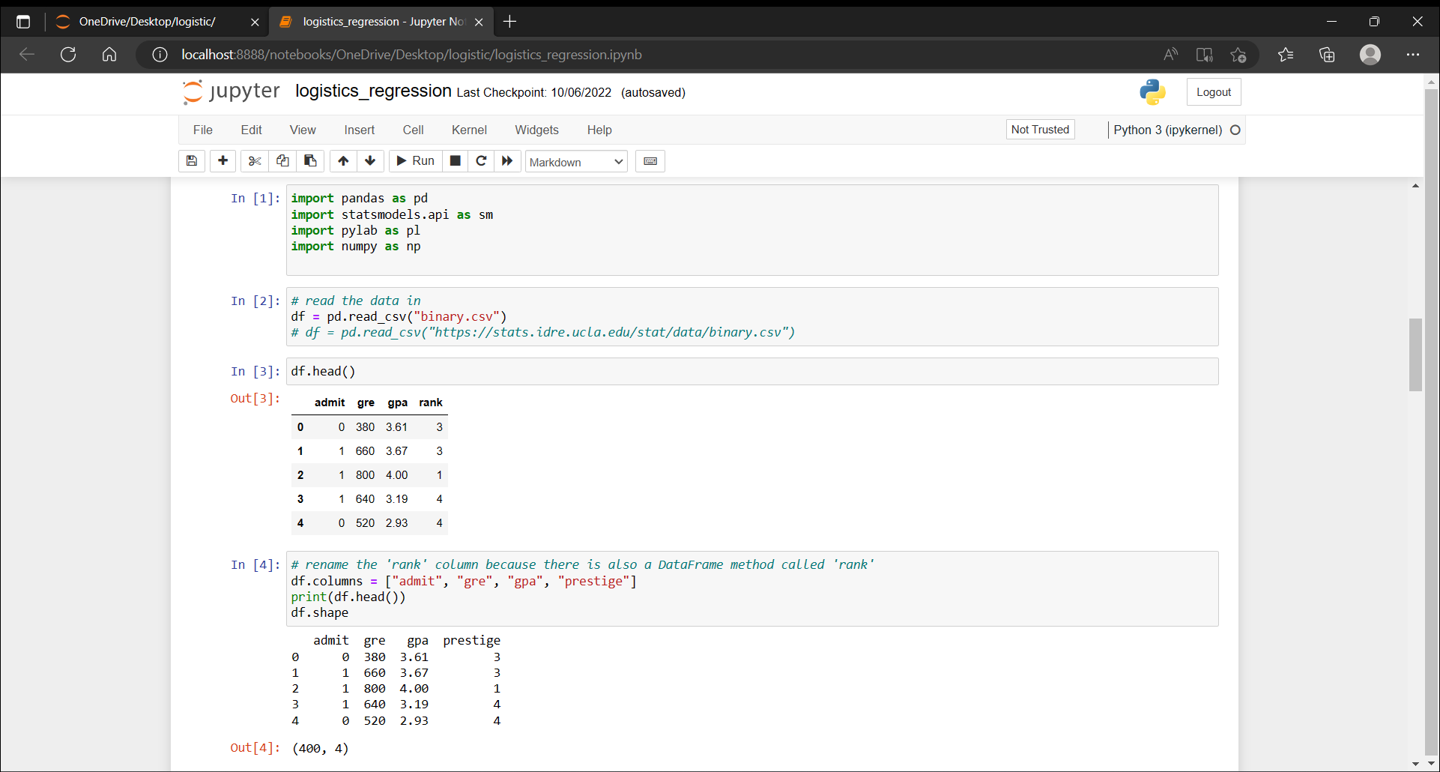
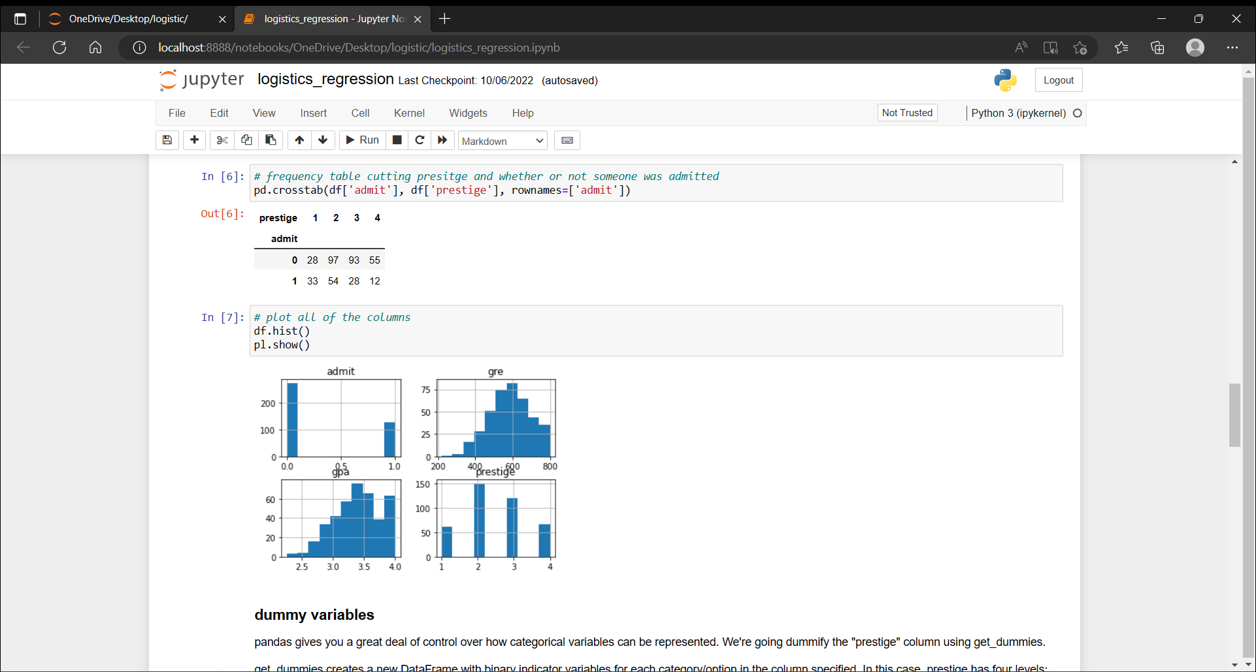
CODE

Slide 10
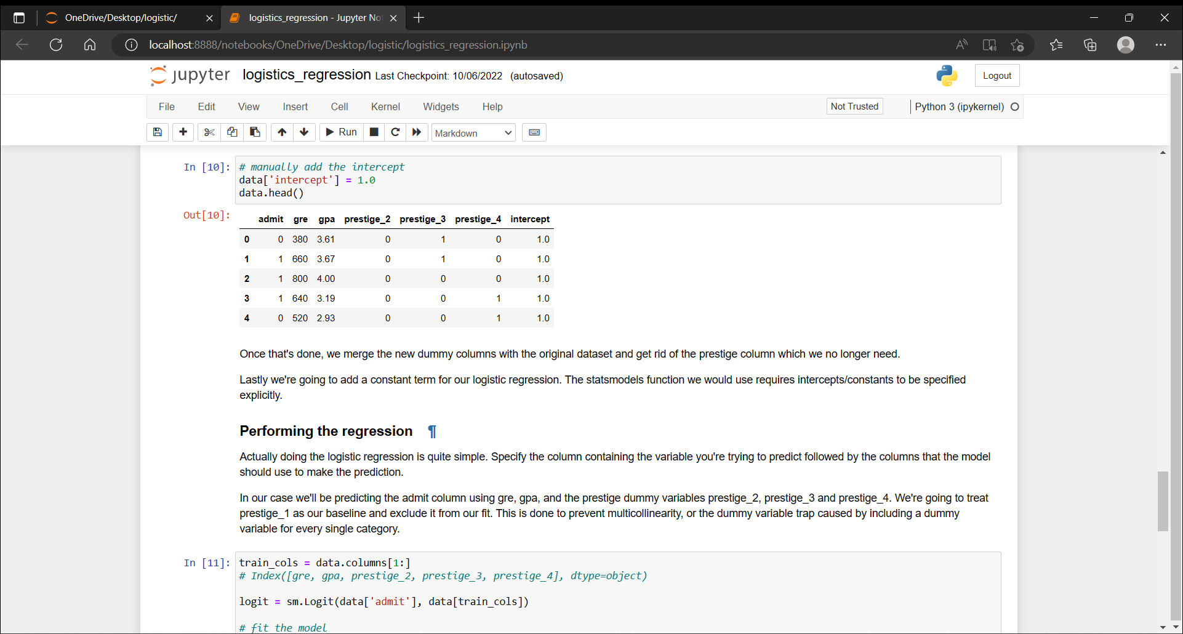
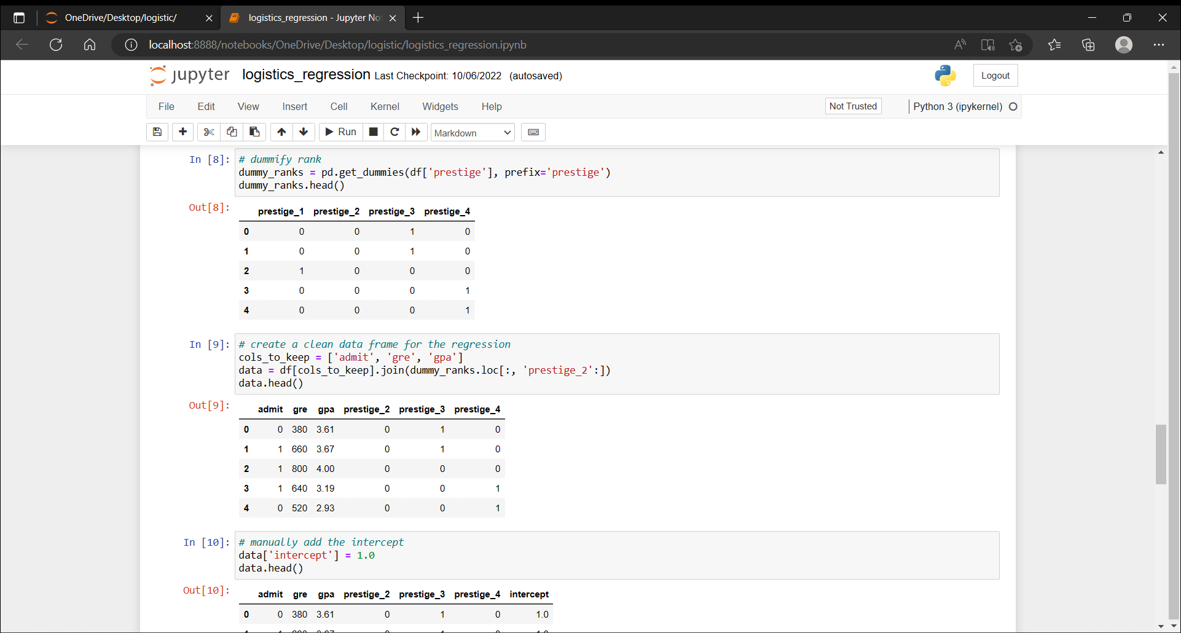
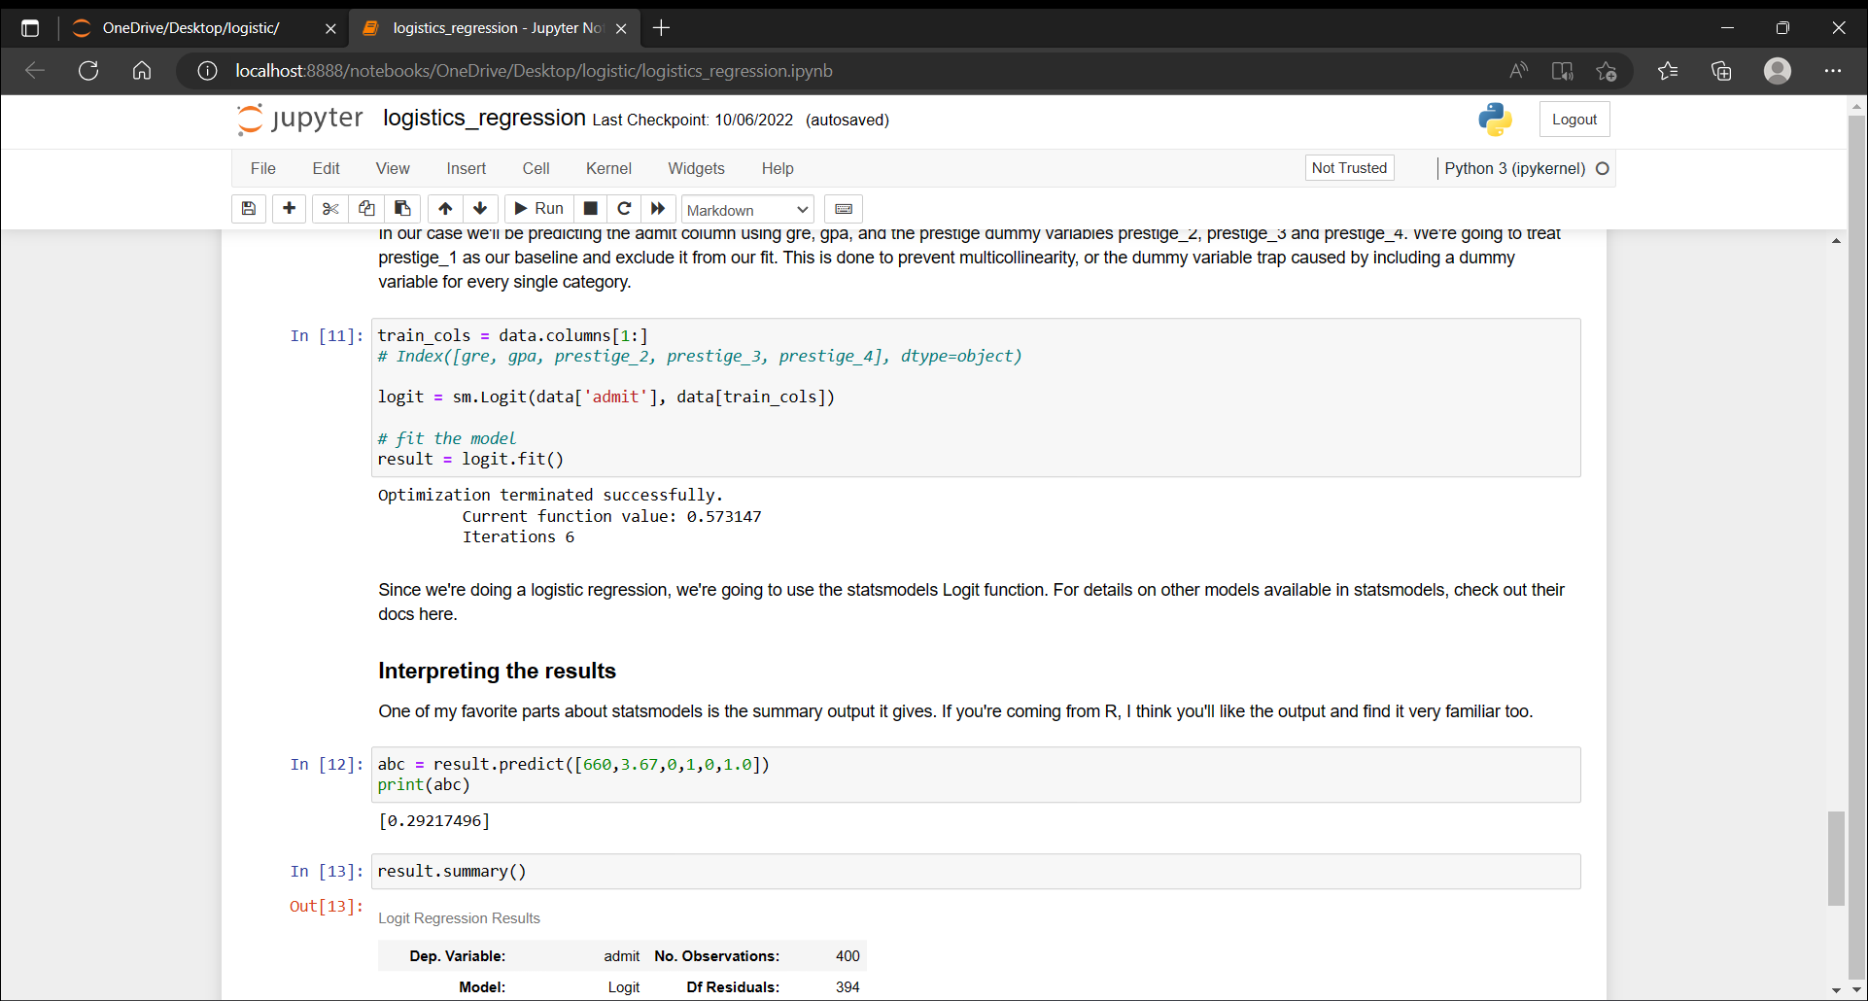

Slide 11
RESULT AND DISCUSSION

Slide 12
CONCLUSION
logistic regression is to provide accurate and reliable predictions.
This model will be helpful for the universities to predict the admission and ease their process of selection and timelines.

Slide 13
REFRENCE
[1] Tolles, Juliana; Meurer, William J (2016). "Logistic Regression Relating Patient Characteristics to Outcomes".
[2] Hosmer, David W.; Lemeshow, Stanley (2000). Applied Logistic Regression .
[3] Walker, SH; Duncan, DB (1967). "Estimation of the probability of an event as a function of several independent variables".
[4] Boyd, C. R.; Tolson, M. A.; Copes, W. S. (1987). "Evaluating trauma care: The TRISS method. Trauma Score and the Injury Severity Score". The Journal of Trauma.

Slide 14
THANK YOU

